Slide 1


Slide 2


Slide 3
Adding F# to Your C# Codebase What you need to know
Jay Hill
jayhill@jayhill.net
@jittery
speakerrate.com/jayhill
github.com/jayhill

Slide 4
Adding F# to Your C# Codebase What you need to know
Jay Hill
jayhill@jayhill.net
@jittery
speakerrate.com/jayhill
github.com/jayhill

Slide 5


Slide 6
Non-Objectives
Convince you that F# is great (it is)
Convince you that C# is so over (it isn’t)
Teach you F#
Get you to add F# to your .NET project
Make false claims about F# or FP

Slide 7

Objectives
Set expectations
Highlight key trade-offs
Provide practical strategies to keep C# and F# interop code idiomatic and clean

Slide 8

Assumptions
You think that F# might be great (it is)
You don’t think C# is a golden hammer (it isn’t)
You don’t think F# is a golden hammer (it is… n’t)
You know or might learn some F#
You’re interested in adding F# to your .NET project
You understand that F# & FP don’t solve all the things

Slide 9

YOU
ME

Slide 10


Slide 11


Slide 12
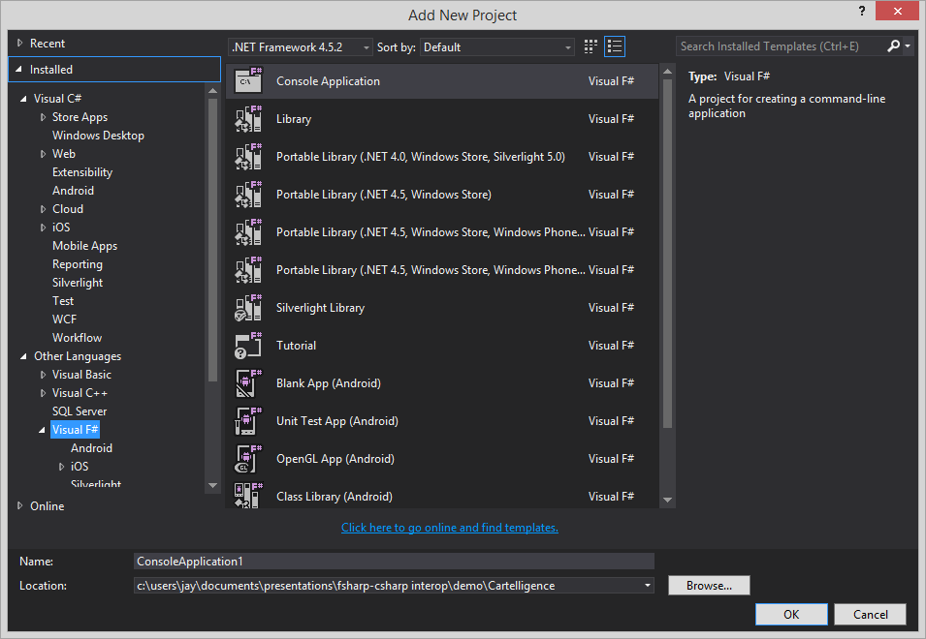
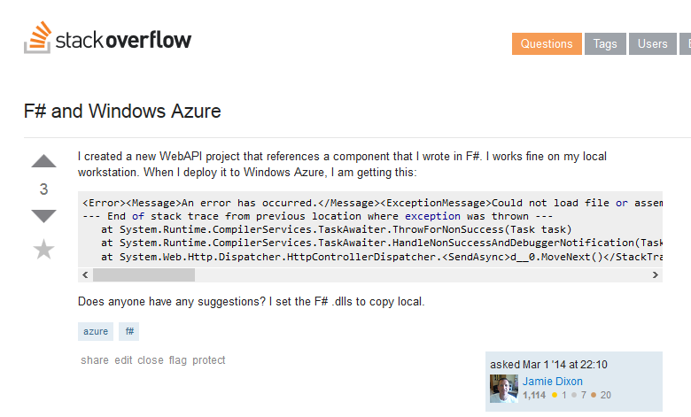
F# is not a first-class citizen

Slide 13

Beloved tools don’t love you back when you use F#
CodeRush

Slide 14

My world is crumbling

Slide 15


Slide 16
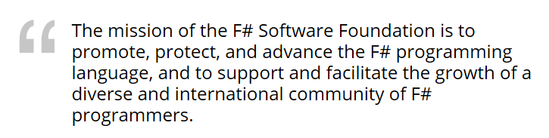
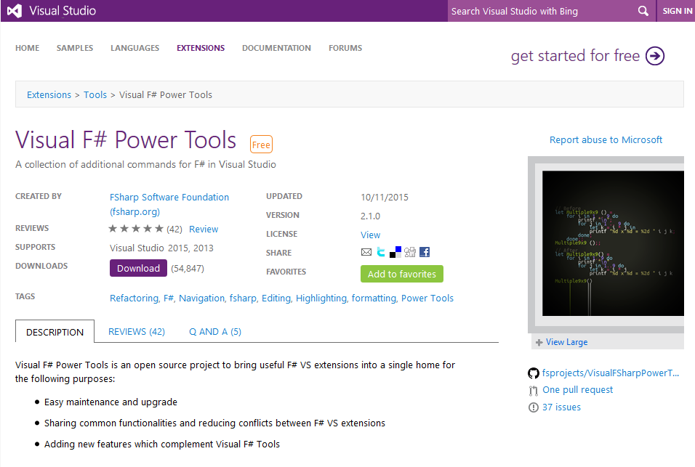
F# is a [growing] community

Slide 17
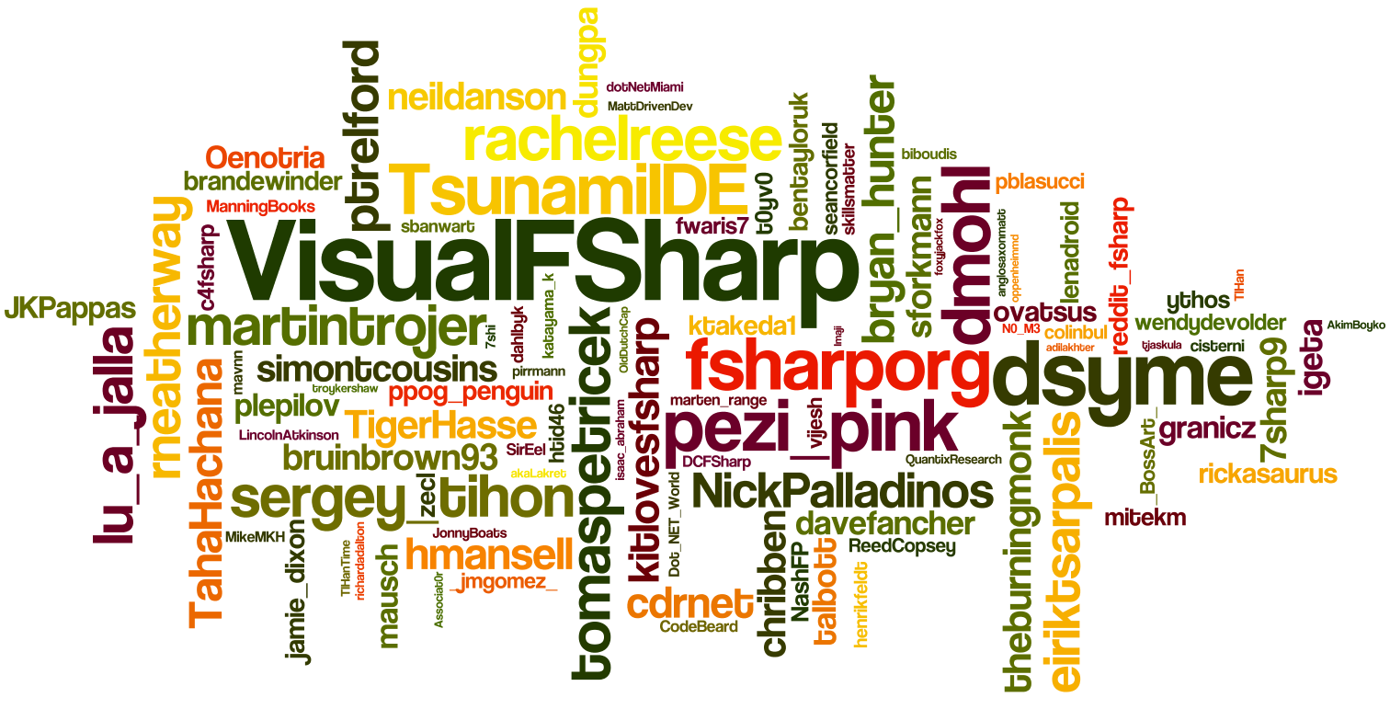
F# is a [growing] community
*Word clouds prove things

Slide 18


F# is fully .NET

Slide 19

Its provenance makes it idiomatically distinctive

Slide 20
Uses many familiar .NET types
open System
string
char
byte
int (16,32,64)
enum
object
etc.

Slide 21
Can use any .NET type
collections
expressions
web
crypto
LINQ
etc.

Slide 22
Idiomatically Distinct

Slide 23
idiomatic code
idiotic code
>

Slide 24

I DON’T ALWAYS WRITE CODE, BUT WHEN I DO,
IT IS IDIOMATIC*

Slide 25
Has its own types
unions
records
collections
tuples
modules
functions

Slide 26
Idiomatically distinct …but IL is IL
unions
records
collections
tuples
modules
functions
.NET

Slide 27
F# ♥ is about features Features are leveraged through idioms
pattern-matching
|> piping
recursion
currying
immutability
null-lessness
_
REPL

Slide 28








Tooling

Slide 29
My world is crumbling

Slide 30
Adapt and carry on

Slide 31


Folding
Visual Studio does not support code folding (collapse/expand).
At all.
Not for modules, not for functions, not for types.
(meh)

Slide 32
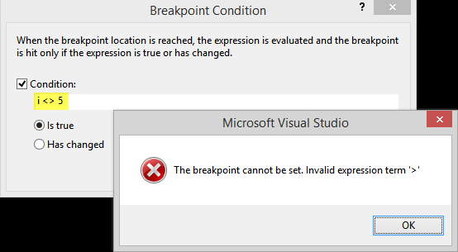
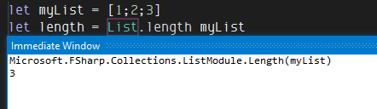
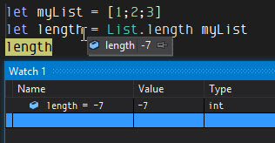
Debugging
Breakpoint conditions, Immediate, Watch and other debugging tools require C#/compiled syntax
…and they allow mutation

Slide 33
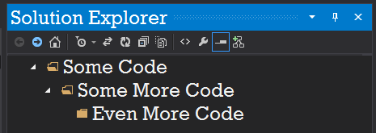
Folders: A Tale of Woe
FACT
Visual Studio does not support folders in F# projects
HOPE
F# Power Tools adds support for folders in VS
RECOMMENDATION
Don’t you do it!

Slide 34
Data Structures
FSharp.Collections FSharp.Core.ExtraTopLevelOperators (ick)
list : FSharpList<T>
map : FSharpMap<TKey,TValue>
set : FSharpSet<T>
F# Power Pack adds other useful structures, such as Matrix<T>.
All of these collection types implement expected generic and non-generic collection interfaces:
IEnumerable, IEnumerable<T>
ICollection, ICollection<T>
IDictionary<TKey, TValue>
etc.

Slide 35
Data Structures
Many F# idioms don’t work without F# types.
No list pattern-matching with IList<T>, only with FSharpList<T>.
let rec matchStrings = function
| [] -> “empty”
| [x] -> “one item: ” + x
| head::tail -> head + “, ” + (matchStrings tail)

Slide 36
Porting Classes
Members cannot be protected
Members cannot be sealed (but classes can fwiw)
Classes cannot be nested (but modules can fwiw)

